Slide 1
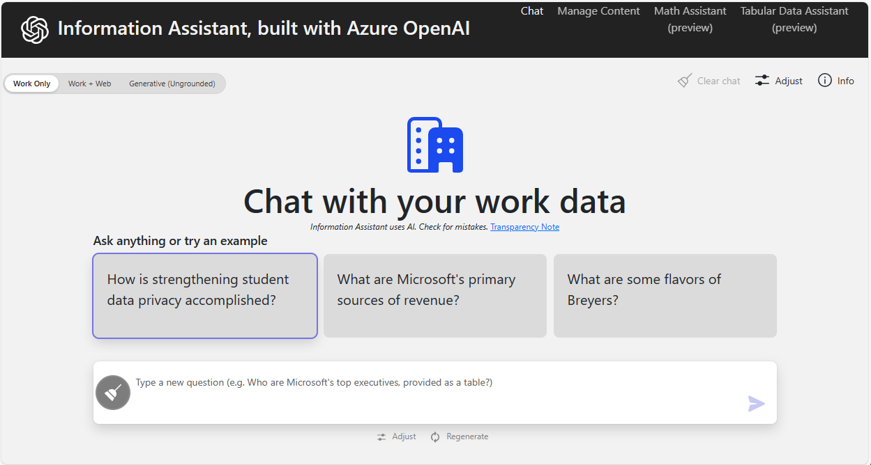
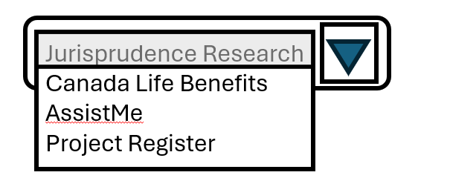


EVA Domain Assistant
EVA DA 2.0 demo – project-aware, bilingual, accessible
Chat with your Jurisprudence Research Assistant

Slide 2

EVA Domain Assistant
EVA DA 2.0 demo – project-aware, bilingual, accessible
Chat with your Canada Life Benefits Assistant

Slide 3

EVA Domain Assistant Project Register Administration
EVA DA 2.0 demo – project-aware, bilingual, accessible
Project:
Field | Type | Purpose
id | string (UUID) | Internal ID
slug | string | Short code (e.g. canada-life, jurisprudence)
name | string | Friendly name shown in UI
description | string | What this project does
status | enum: draft | active | archived | Lifecycle state
ownerName | string | Business owner / team
ownerEmail | string | Contact for issues
costCenter | string | For chargeback / reporting
securityClassification | enum: UNCLASS | PB / etc | For EVA: likely UNCLASS or PB
allowedUserGroups | string[] | RBAC groups / roles allowed
defaultLanguage | enum: en | fr | Primary language
supportedLanguages | string[] | e.g. ["en", "fr"]
uiTheme | object | Colors / branding for the React app
ragIndexConfig | RagIndexConfig | How we chunk/index
ragRetrievalConfig | RagRetrievalConfig | How we rank/retrieve
ragPromptConfig | RagPromptConfig | Persona, system prompts
ragGuardrailConfig | RagGuardrailConfig | Safety / redaction config
dataSources | DataSource[] | Where content comes from
goldenQuestionSet | GoldenQuestion[] | Golden questions & expectations
analyticsConfig | AnalyticsConfig | KPI & logging knobs
createdAt | datetime | Audit
createdBy | string | Audit
updatedAt | datetime | Audit
updatedBy | string | Audit
Chat with your Canada Life Benefits Assistant
Cancel
Save
Exit Project Register

